Slide 1
Advanced Programming Practice Project

Slide 2
Flipping tile Memory game

Slide 3
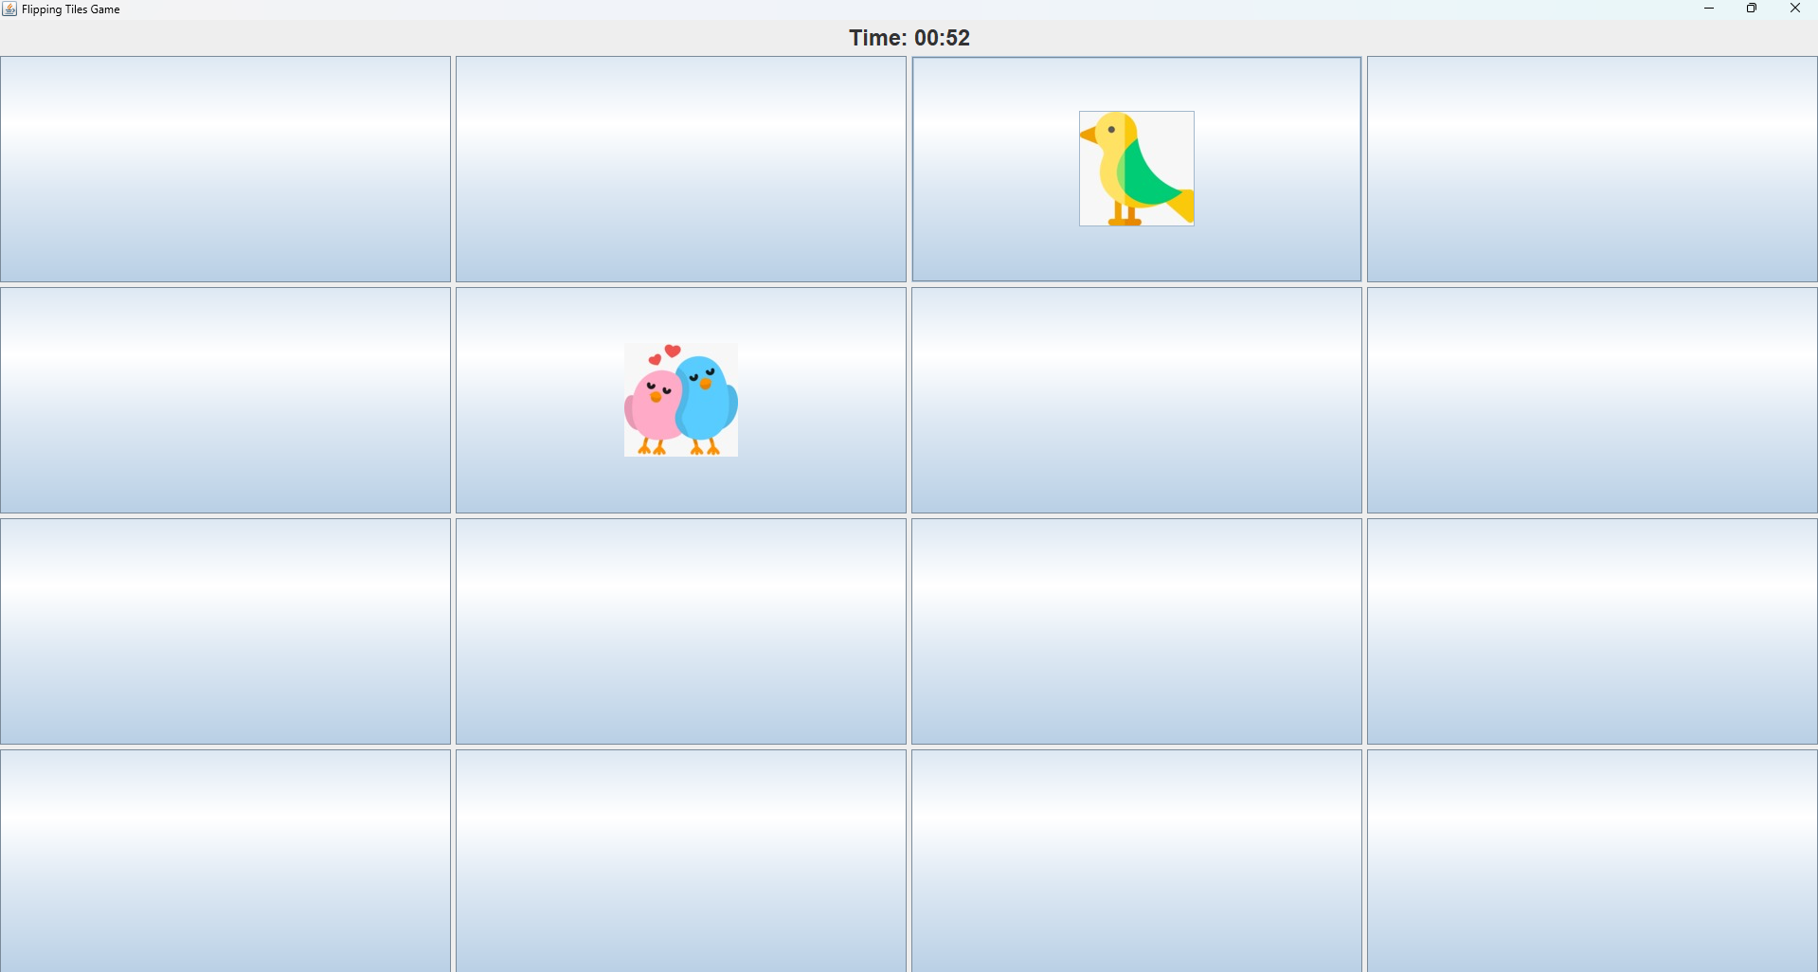
Introduction to Tile Flipping Game
The Flipping Tile Game is a classic puzzle game developed using Java, where the objective is to flip tiles to match a predefined pattern or achieve a specific goal. Each tile in the game can flip between two states, and flipping one tile may also affect its neighboring tiles.
This game helps players develop problem-solving skills and critical thinking by strategizing their moves to solve the puzzle in the least number of flips.

Slide 4
Abstract
The Flipping Tile Game is a Java-based puzzle game designed to challenge players' strategic thinking and problem-solving skills. The objective of the game is to flip a series of tiles to match a specific pattern, with each flip potentially affecting neighboring tiles. The game was developed using Java's Swing library for graphical user interface (GUI) design and employs event handling to manage user interactions. Key programming concepts such as recursion, loops, and object-oriented programming (OOP) are integrated into the game's logic to create an interactive and engaging user experience. This project serves as a practical demonstration of game development principles in Java, providing players with a fun and educational challenge.

Slide 5
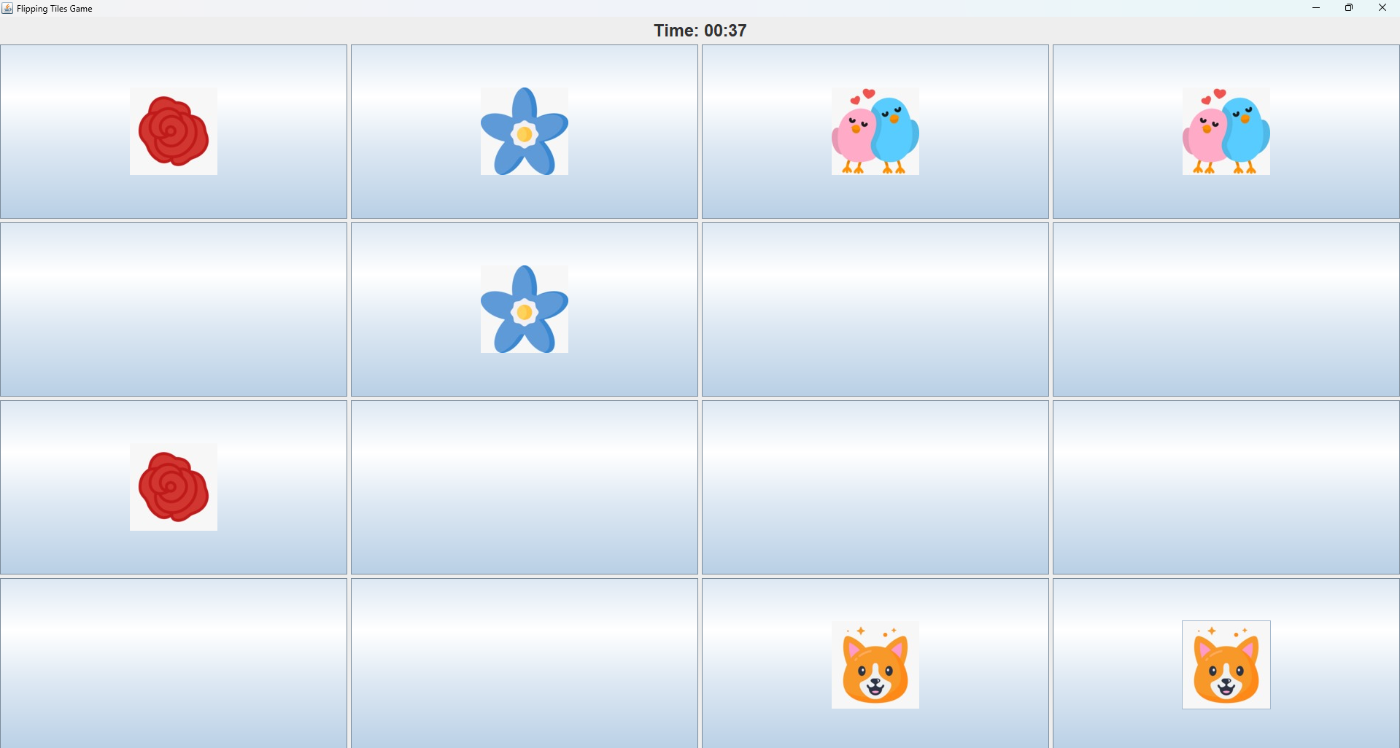
Implementing Game Logic
The core of our tile ﬂipping game lies in the game logic. We will create classes for tiles, manage their states, and implement methods to handle tile ﬂipping and matching. Understanding object-oriented programming principles is key to structuring your code effectively.

Slide 6
Working
Class and GUI Setup
The game is organized in a main class that sets up the game window using JFrame.
A 2D grid of tiles is created using JButton components, placed inside a JPanel with a GridLayout for neat arrangement.
Tile Initialization
Each tile (button) is initialized with a default appearance, such as a specific background color.
An ActionListener is attached to each tile to handle the click events.
Tile Click Listener
When a tile is clicked, the ActionListener triggers the tile flipping logic.
The tile's color is toggled to indicate its state has changed (e.g., from white to black and vice versa).
Depending on the game rules, adjacent tiles may also flip by checking neighboring tile positions and updating their states.
Flipping Logic
The flipTile() method changes the tile's current state. If it’s "unflipped" (e.g., white), it becomes "flipped" (e.g., black) and vice versa.
Optionally, flipAdjacentTiles() can flip neighboring tiles in the grid, based on the current tile's position.
Checking the Win Condition
After every tile click, the game checks if all tiles are in the desired state (e.g., all tiles are flipped to black).
If the player wins, a dialog box (JOptionPane) is used to display a victory message.
Reset and Replay
The game provides a reset button to allow the player to restart the game, resetting all tile states to their initial values.

Slide 7
Technology Used:
Java
The primary programming language used to develop the game.
Provides platform independence and object-oriented features.
Swing
A part of Java's Standard Library used for creating Graphical User Interfaces (GUI).
Provides lightweight, flexible components like buttons, panels, and labels for building the game's interface.
Java AWT (Abstract Window Toolkit)
Supports event handling and graphical rendering.
Works alongside Swing to capture user actions like tile clicks.
Event Handling
ActionListeners and MouseListeners are used to detect and respond to player interactions such as tile flips.
Layouts (GridLayout/BorderLayout)
Organizes the tiles and components within the game window.
Ensures the game board is visually consistent and easy to navigate.
Java 2D API
Used for rendering and customizing the visual appearance of the tiles and other graphical elements.

Slide 8
Conclusion
The Flipping Tile Game developed in Java using Swing demonstrates the effective use of graphical user interfaces, event-driven programming, and object-oriented design. This project provided valuable insights into building interactive games, handling user input, and implementing complex game logic in a structured way. The use of Java's GUI libraries, such as Swing and AWT, allowed for a smooth and engaging user experience while showcasing the flexibility of Java for desktop applications.

Slide 9
Python Music Player

Slide 10
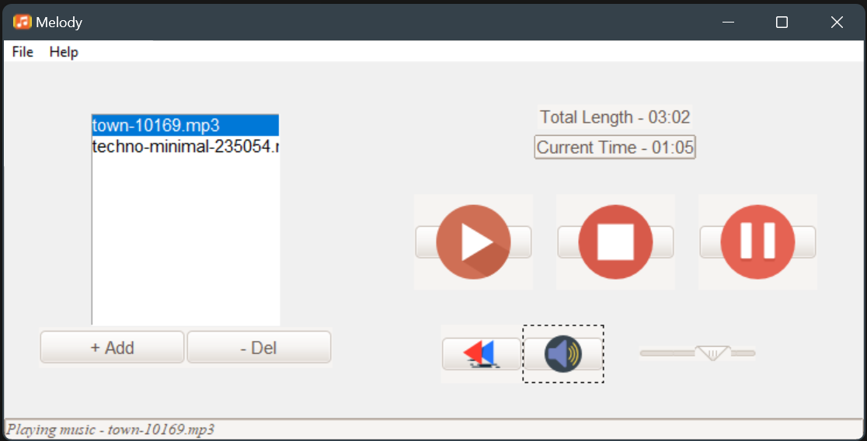
Introduction to Python Music Player
The Python Music Player is a simple yet functional application designed to provide a seamless music playback experience. Built using the Tkinter library for the graphical user interface (GUI) and the Pygame library for audio management, this music player allows users to easily navigate and enjoy their favorite tracks.

Slide 11
Abstract
The Python Music Player project is a desktop application designed to provide an accessible and user-friendly interface for playing and managing audio files, specifically MP3 format. Leveraging the Tkinter library for graphical user interface (GUI) development and Pygame for audio playback, this project aims to deliver a straightforward music listening experience.
The application allows users to browse their file system and add music files to a dynamic playlist. It features essential playback controls, including play, pause, stop, and rewind, alongside volume control and mute functionality. Additionally, the player displays the total length and current playback time of tracks, enhancing user engagement.

Slide 12
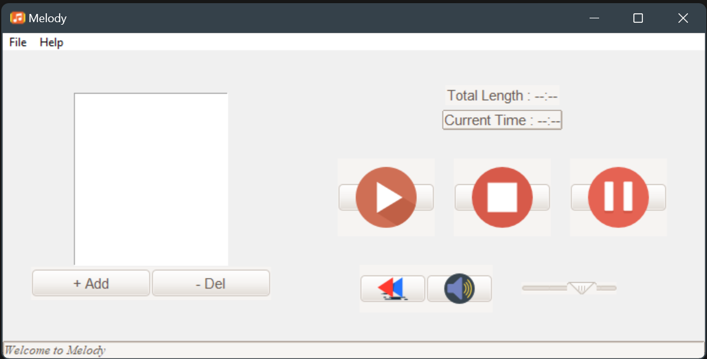
Introduction to Python Music Player Logic
The logic of the Python Music Player integrates these components seamlessly to create a functional and enjoyable user experience. By effectively managing audio playback, user interactions, and the graphical interface, this application exemplifies how to combine programming concepts to build a practical software tool.

Slide 13
Working
The Python Music Player is a desktop application built using Tkinter for the GUI and Pygame for audio playback. It allows users to browse and add MP3 files to a playlist, displaying track information and providing controls for play, pause, stop, rewind, and volume adjustment. The application updates the current playback time in real-time using a separate thread. Volume control and mute functionalities enhance user experience. Error handling ensures smooth operation by alerting users to issues like missing files. Overall, the code combines various components to create an intuitive and functional music listening experience.

Slide 14
Technology Used
1. Python: The primary programming language used to develop the application, known for its readability and ease of use.
2. Tkinter: A standard Python library for creating graphical user interfaces (GUIs). It provides various widgets like buttons, labels, and list boxes for building the app's interface.
3. Pygame: A library that facilitates game development but is also used here for audio playback. It manages sound initialization, playback, volume control, and handling various audio formats.
4. Mutagen: A Python module used for handling audio metadata. In this application, it reads MP3 file properties, such as track length.
5. Threading: Python’s built-in threading module allows the application to update the current playback time without freezing the GUI, ensuring a smooth user experience.
6. Image Files: PNG images are used for the control buttons (play, pause, stop, etc.) to enhance the visual appeal of the application.

Slide 15
Conclusion
The Python Music Player project effectively combines Tkinter and Pygame to create a functional desktop application for music playback. It offers features such as playlist management, playback controls, volume adjustment, and real-time time display, ensuring an intuitive user experience. The implementation of error handling and threading enhances stability and responsiveness. Overall, this project serves as a practical tool for music enjoyment and as an educational resource for developers looking to improve their skills in Python and GUI development.

Slide 16
Thanks!

